Slide 1
INTRODUCTION TO
ALGORITHMS
FOURTH EDITION

Slide 2
LECTURE NOTES FOR CHAPTER 8
Sorting in Linear Time

Slide 3
CHAPTER 8 OVERVIEW
How fast can we sort?
We will prove a lower bound, then beat it by playing a different game.
Comparison sorting
The only operation that may be used to gain order information about a sequence is comparison of pairs of elements.
All sorts seen so far are comparison sorts: insertion sort, selection sort, merge sort, quicksort, heapsort, treesort.

Slide 4
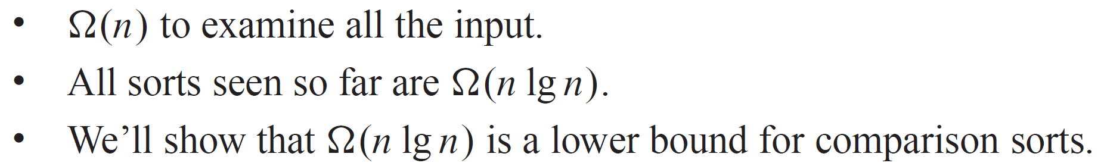
LOWER BOUNDS FOR SORTING
Lower bounds

Slide 5
LOWER BOUNDS FOR SORTING (continued)
Decision tree
Abstraction of any comparison sort.
Represents comparisons made by
a specific sorting algorithm
on inputs of a given size.
Abstracts away everything else: control and data movement.
We’re counting only comparisons.

Slide 6
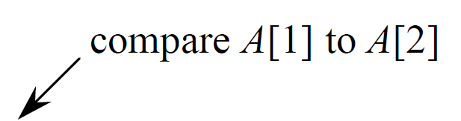
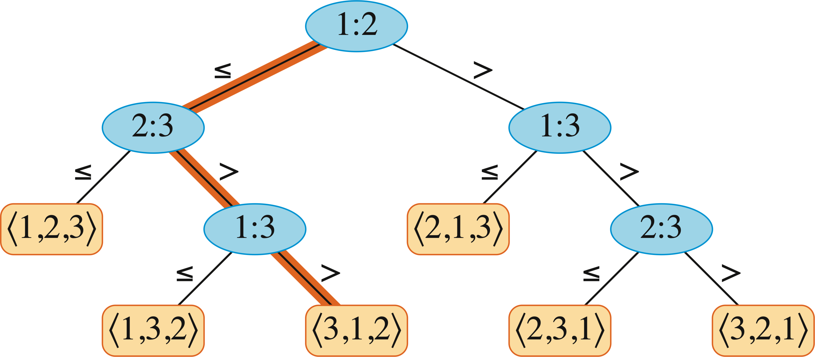
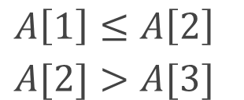
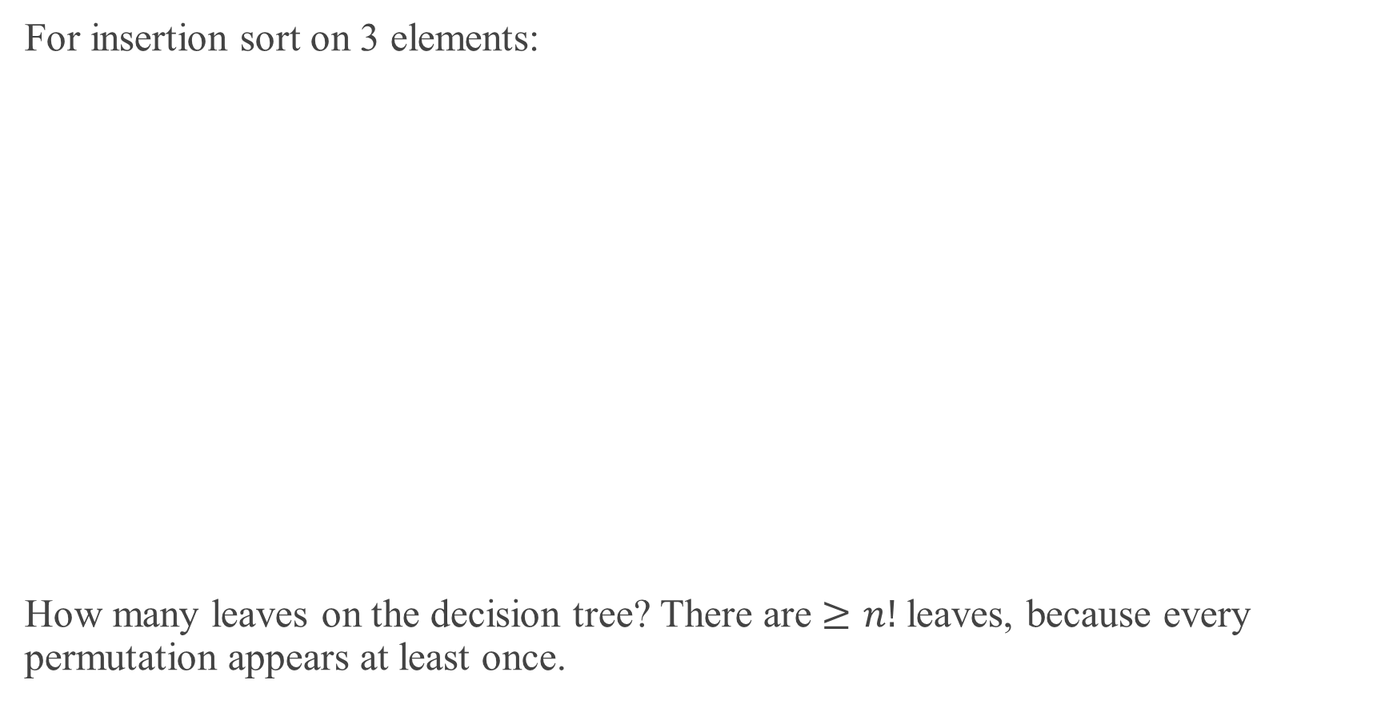
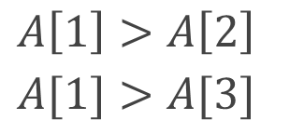
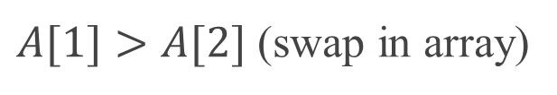
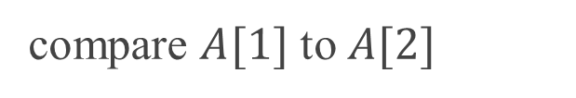
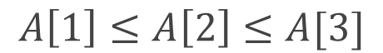
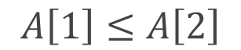
LOWER BOUNDS FOR SORTING (continued)
For insertion sort on 3 elements:
How many leaves on the decision tree? There are $≥n!$leaves, because every permutation appears at least once.
compare $A[1]$ to $A[2]$
$$A\left[1\right]≤A\left[2\right]$$
$A[1]>A[2]$ (swap in array)
$A\left[1\right]≤A\left[2\right]$
$$A[2]>A[3]$$
$A\left[1\right]>A\left[2\right]$
$$A[1]>A[3]$$
$$A\left[1\right]≤A\left[2\right]≤A[3]$$

Slide 7
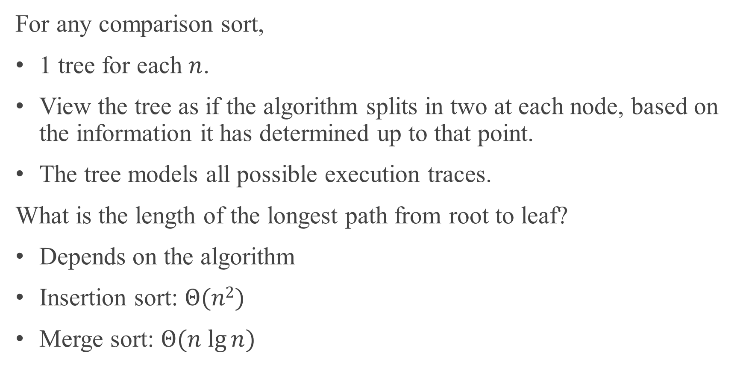
LOWER BOUNDS FOR SORTING (continued)
For any comparison sort,
1 tree for each $n$.
View the tree as if the algorithm splits in two at each node, based on the information it has determined up to that point.
The tree models all possible execution traces.
What is the length of the longest path from root to leaf?
Depends on the algorithm
Insertion sort: $Θ(n2)$
Merge sort: $Θ(n lg⁡n)$

Slide 8
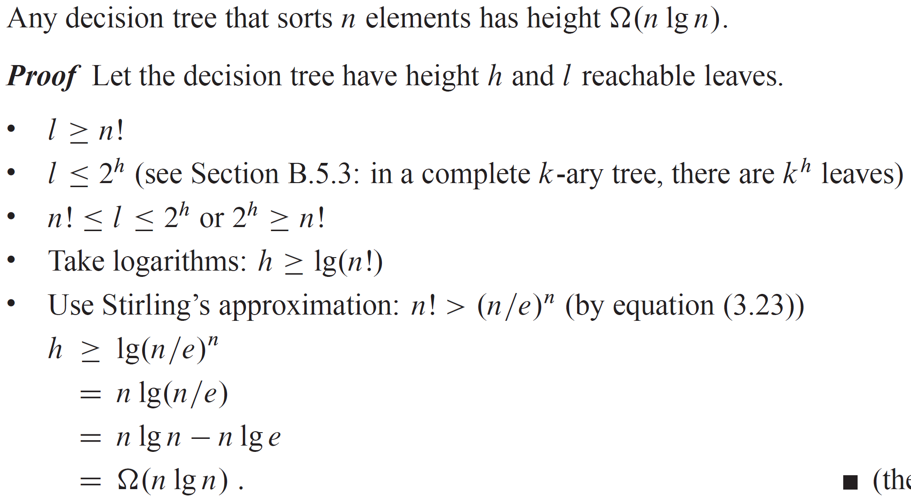
THEOREM

Slide 9
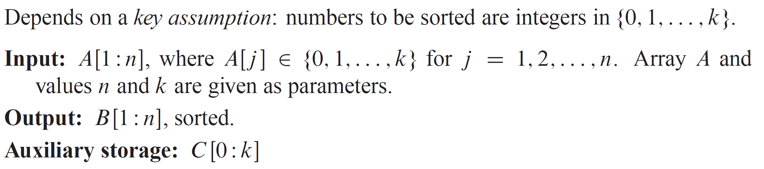
SORTING IN LINEAR TIME
Counting sort

Slide 10
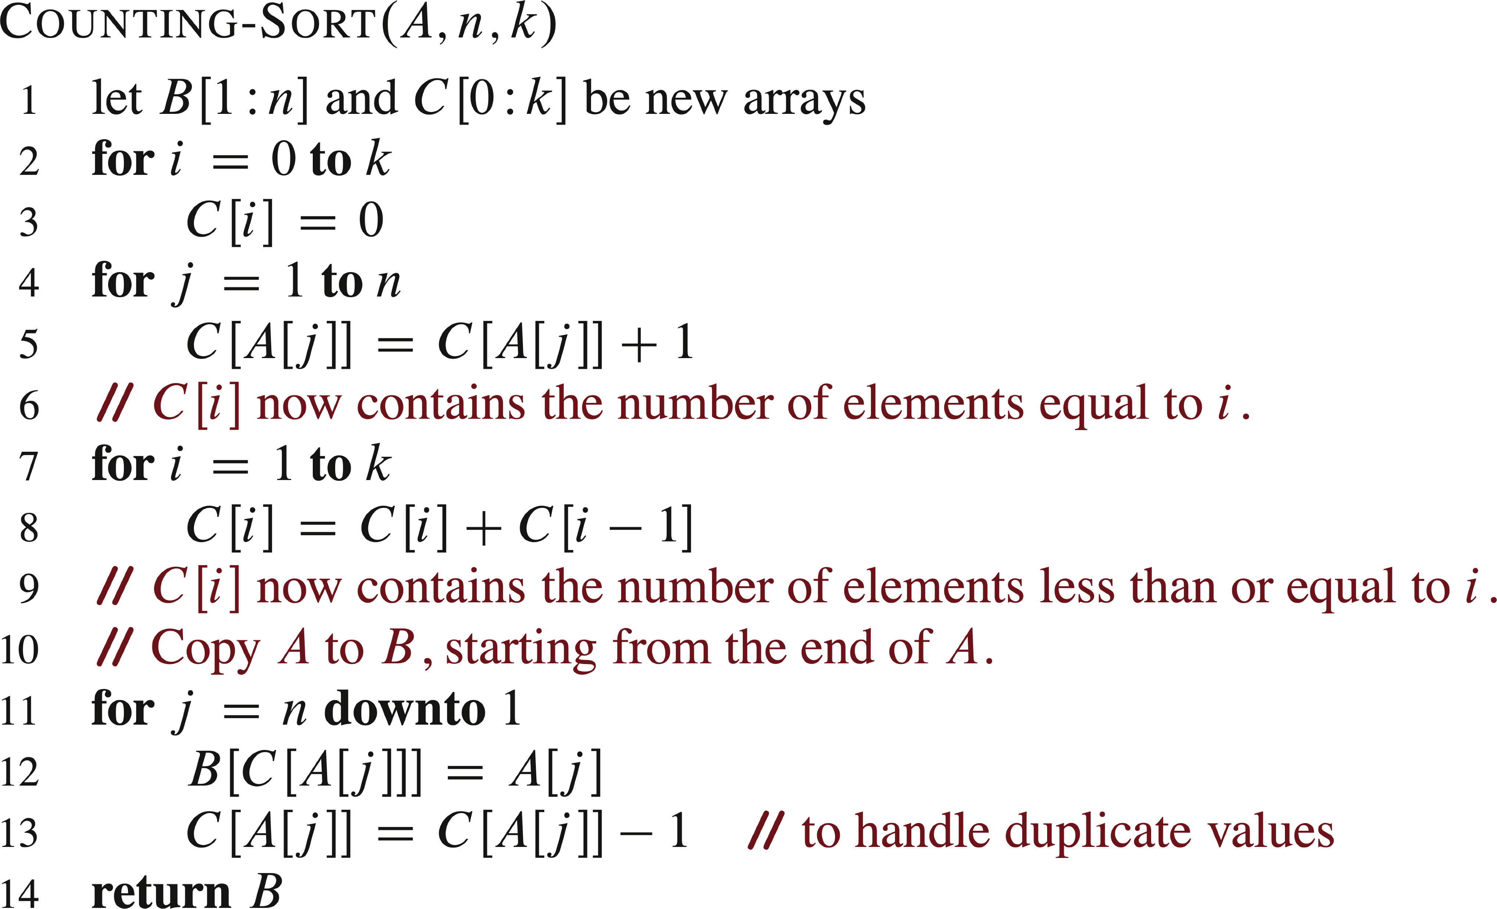
PSEUDOCODE

Slide 11
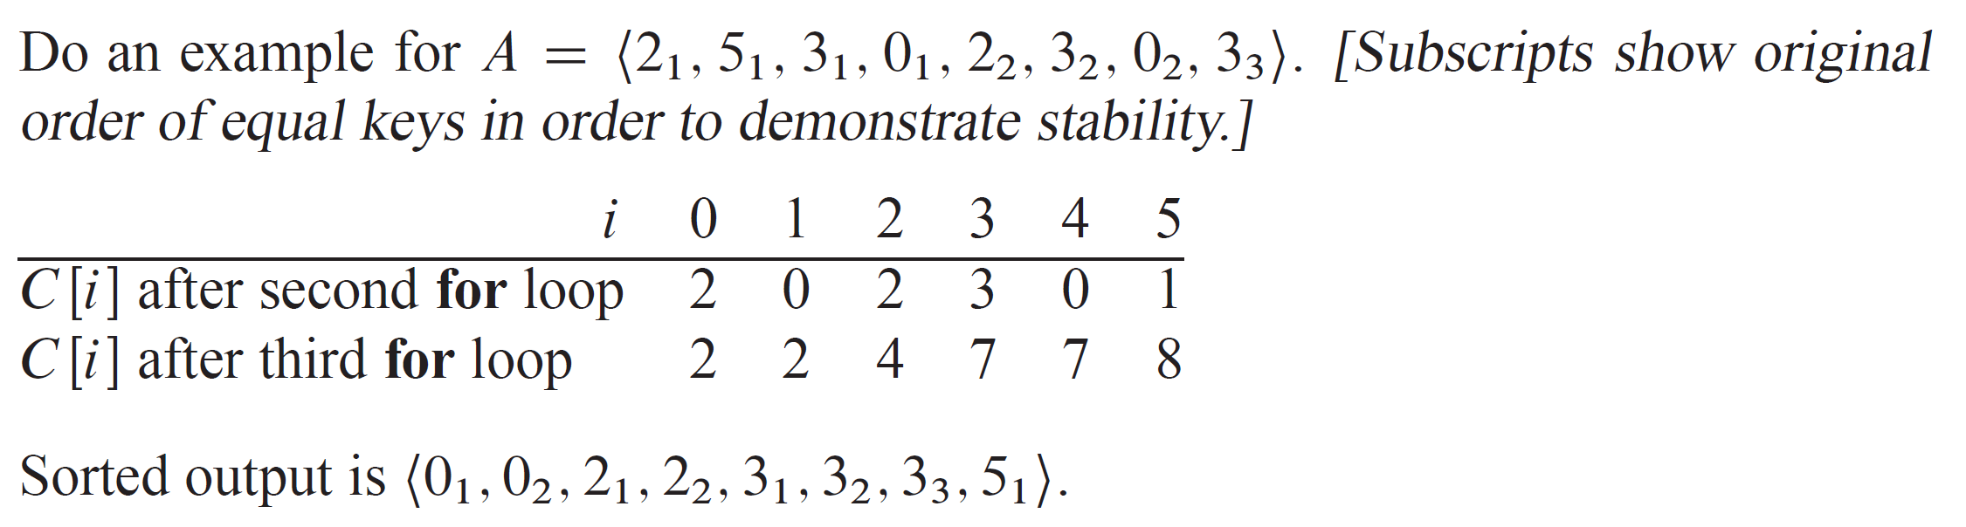
SORTING IN LINEAR TIME (continued)

Slide 12
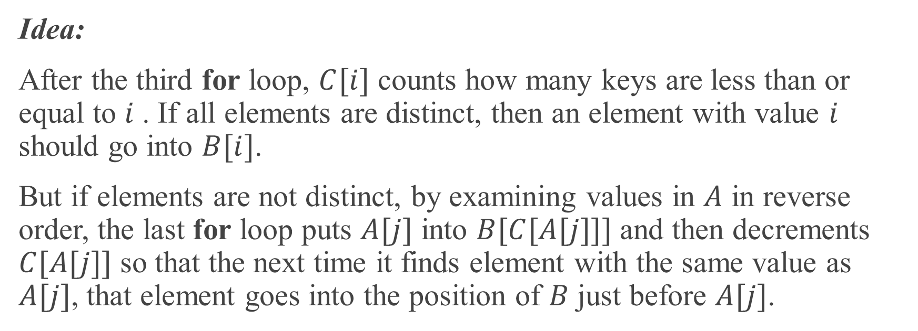
SORTING IN LINEAR TIME (continued)
Idea:
After the third for loop, $C[i]$ counts how many keys are less than or equal to $i$ . If all elements are distinct, then an element with value $i$ should go into $B[i]$.
But if elements are not distinct, by examining values in $A$ in reverse order, the last for loop puts $A[j]$ into $B[C[A[j]]]$ and then decrements $C[A[j]]$ so that the next time it finds element with the same value as $A[j]$, that element goes into the position of $B$ just before $A[j]$.

Slide 13
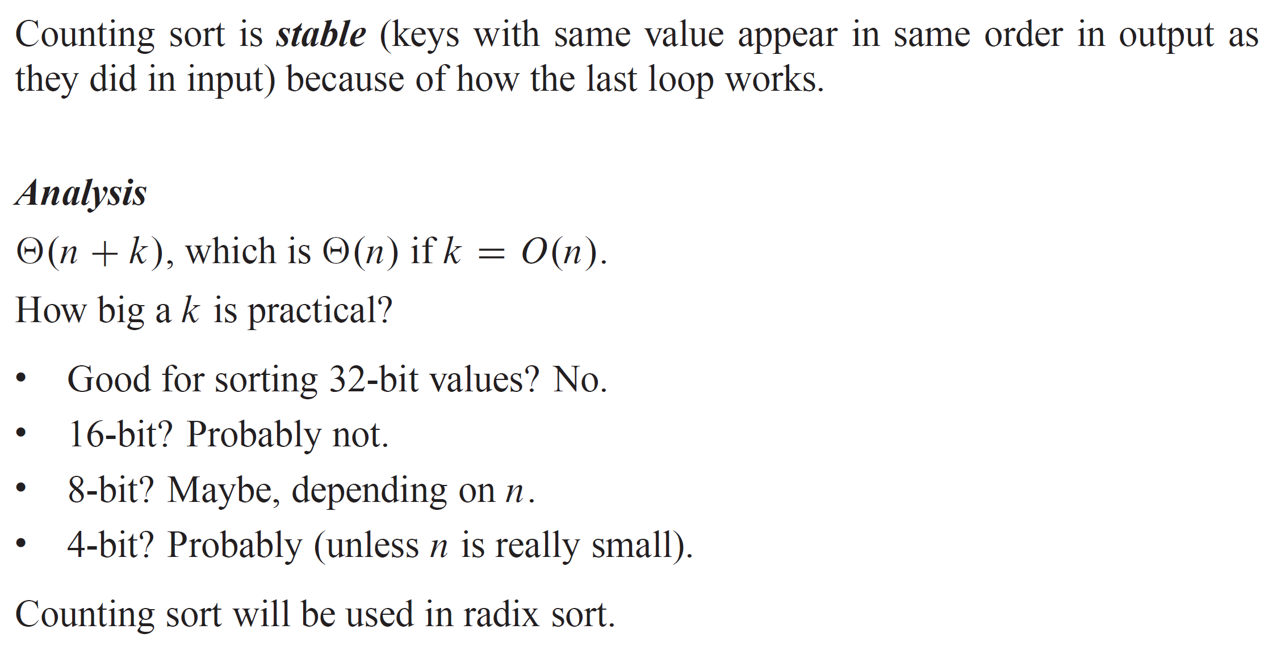
SORTING IN LINEAR TIME (continued)

Slide 14
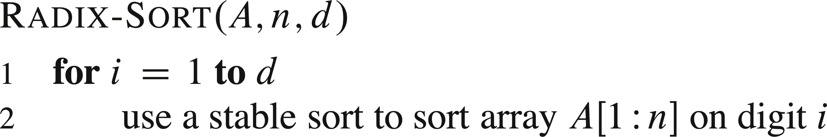
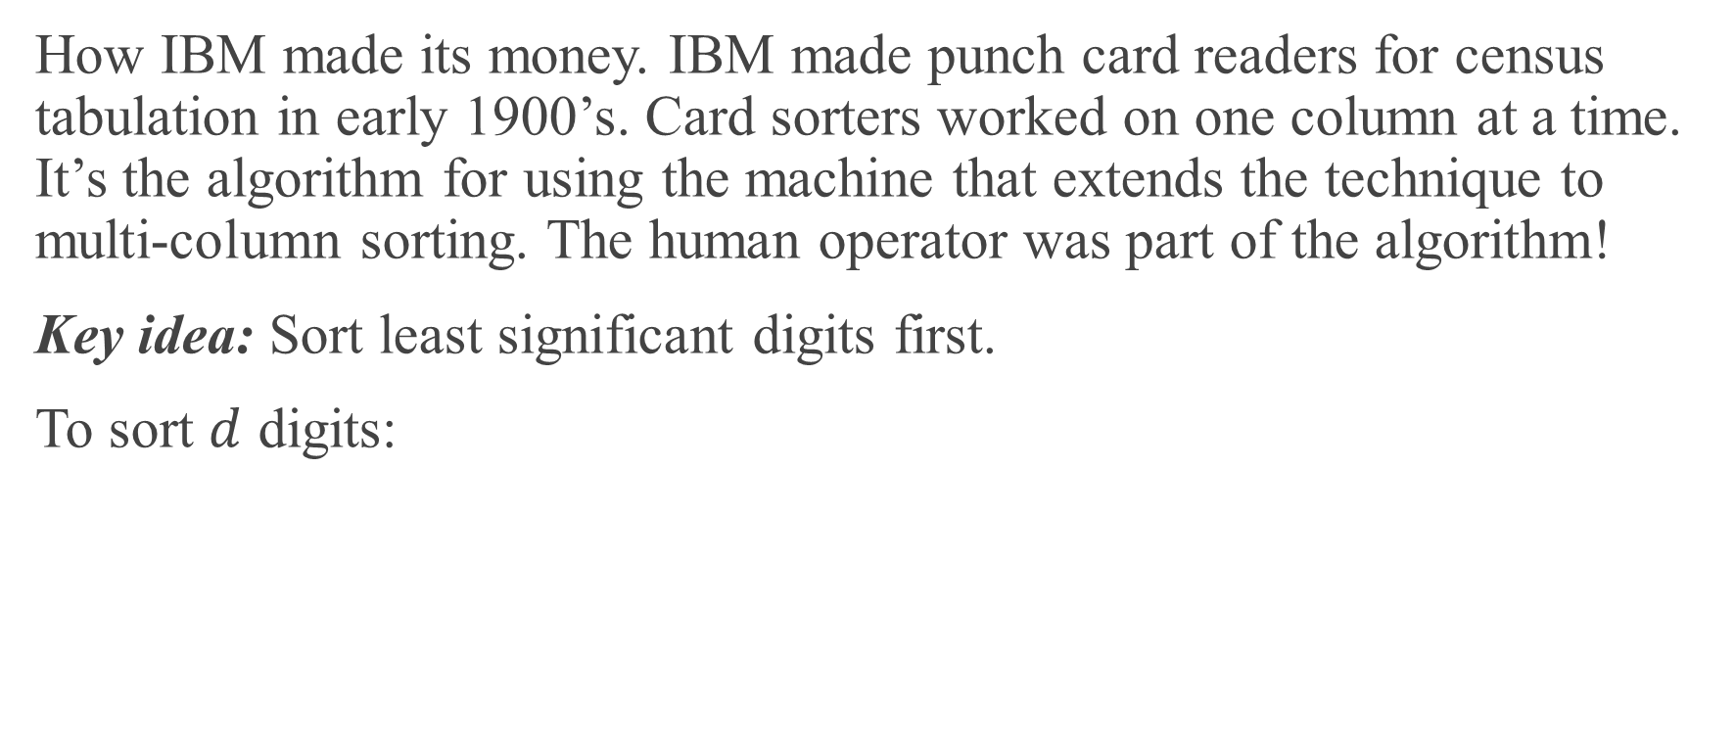
RADIX SORT
How IBM made its money. IBM made punch card readers for census tabulation in early 1900’s. Card sorters worked on one column at a time. It’s the algorithm for using the machine that extends the technique to multi-column sorting. The human operator was part of the algorithm!
Key idea: Sort least significant digits first.
To sort $d$ digits:

Slide 15
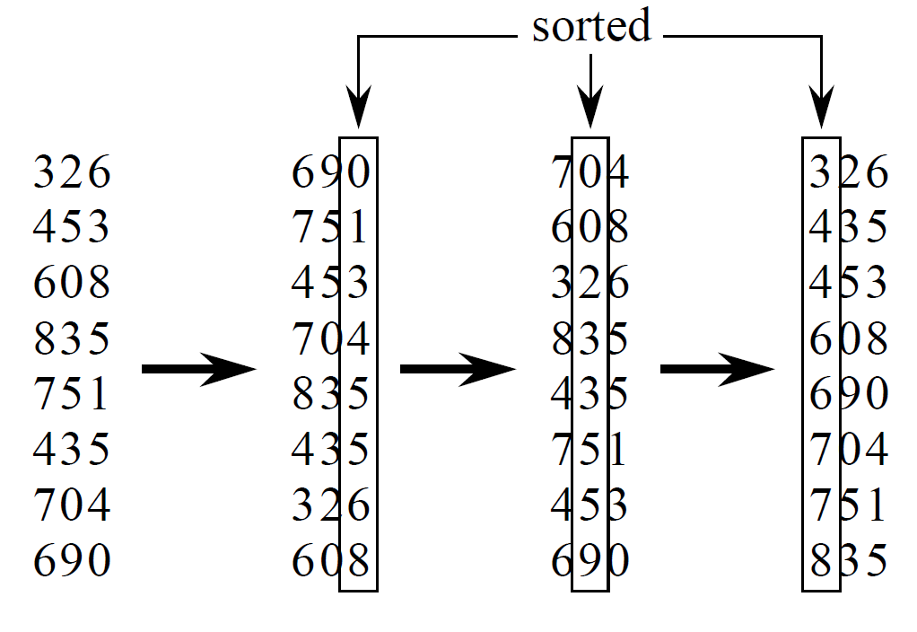
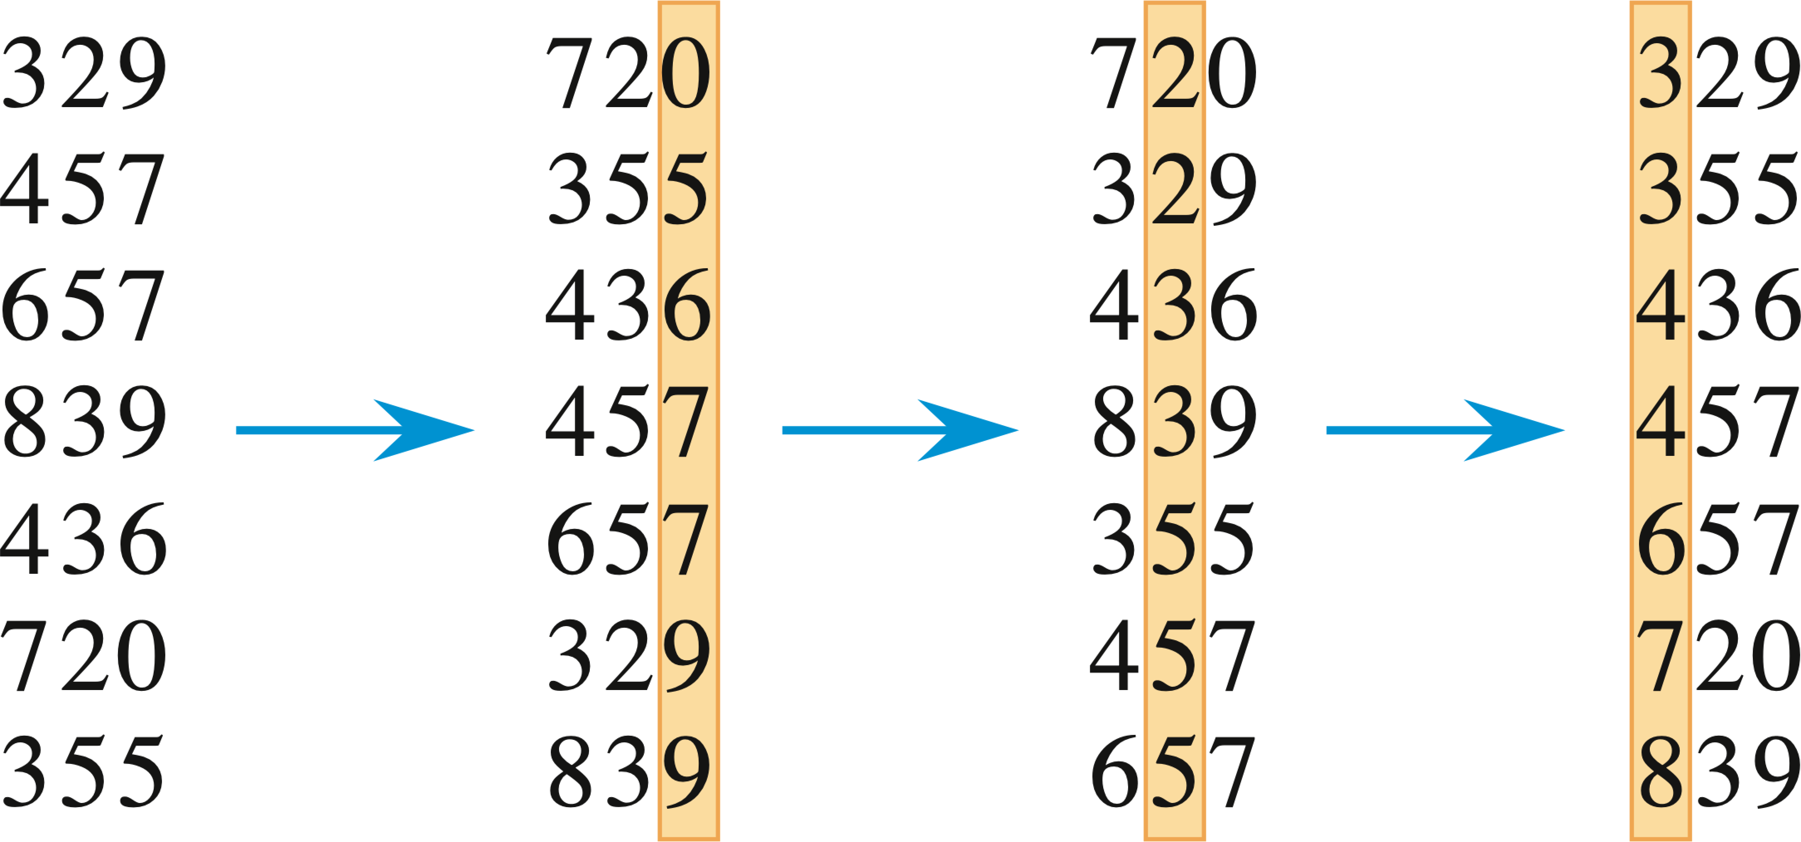
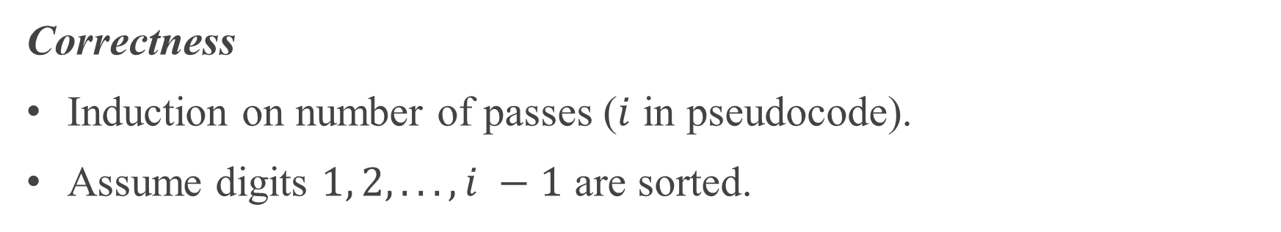
EXAMPLE
Correctness
Induction on number of passes ($i$ in pseudocode).
Assume digits $1, 2, . . . , i −1$ are sorted.

Slide 16
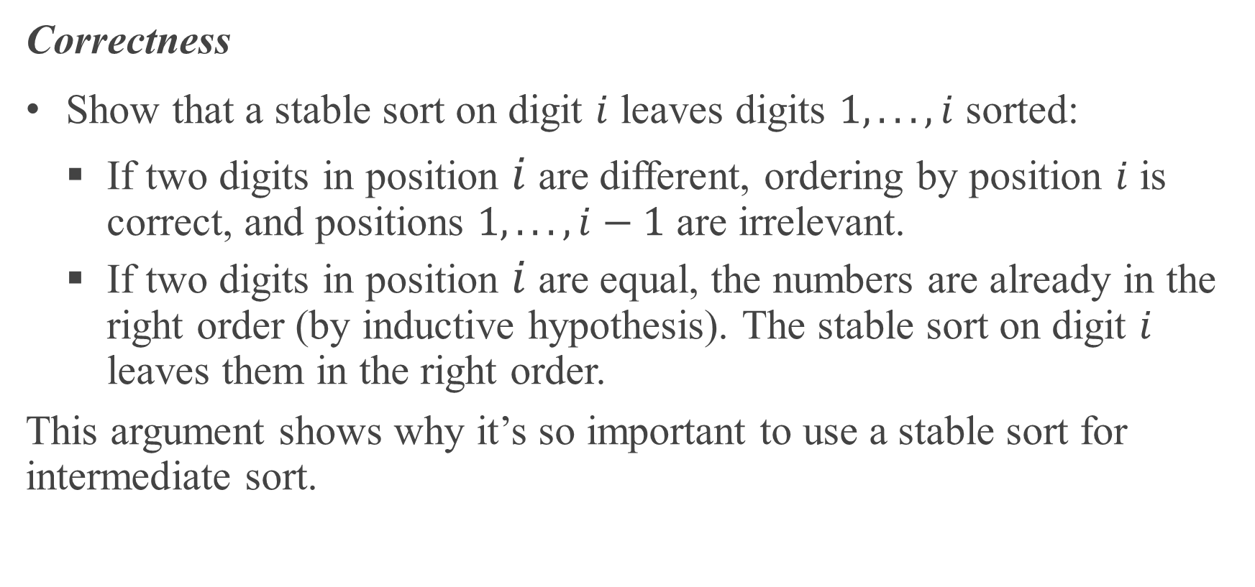
EXAMPLE (continued)
Correctness
Show that a stable sort on digit $i$ leaves digits $1, .. . , i$ sorted:
If two digits in position $i$ are different, ordering by position $i$ is correct, and positions $1, .. . , i−1$ are irrelevant.
If two digits in position $i$ are equal, the numbers are already in the right order (by inductive hypothesis). The stable sort on digit $i$ leaves them in the right order.
This argument shows why it’s so important to use a stable sort for intermediate sort.

Slide 17
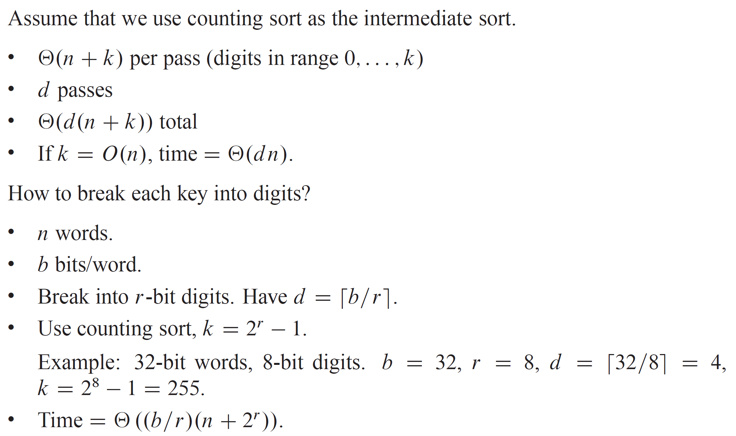
ANALYSIS

Slide 18
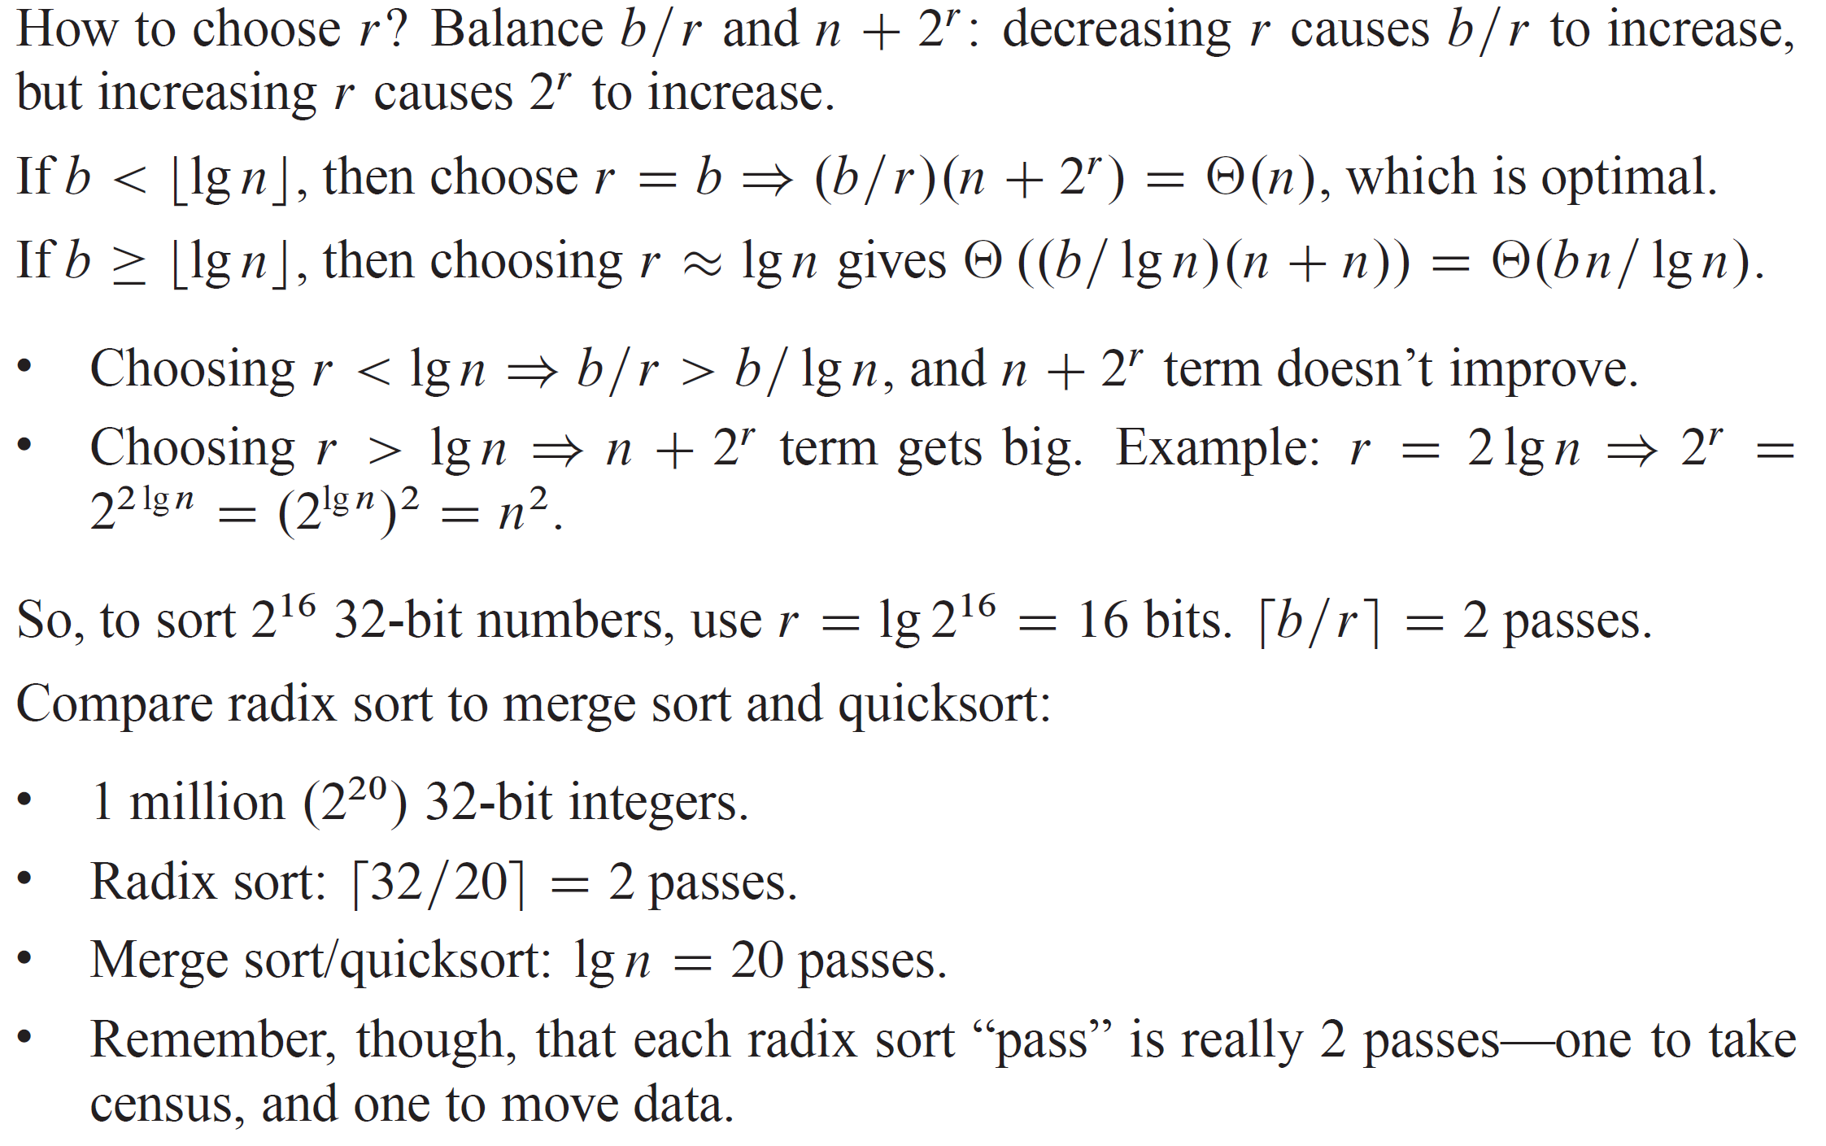
ANALYSIS (continued)

Slide 19
ANALYSIS (continued)

Slide 20
ANALYSIS (continued)
How does radix sort violate the ground rules for a comparison sort?
Using counting sort allows us to gain information about keys by means other than directly comparing two keys.
Used keys as array indices.

Slide 21
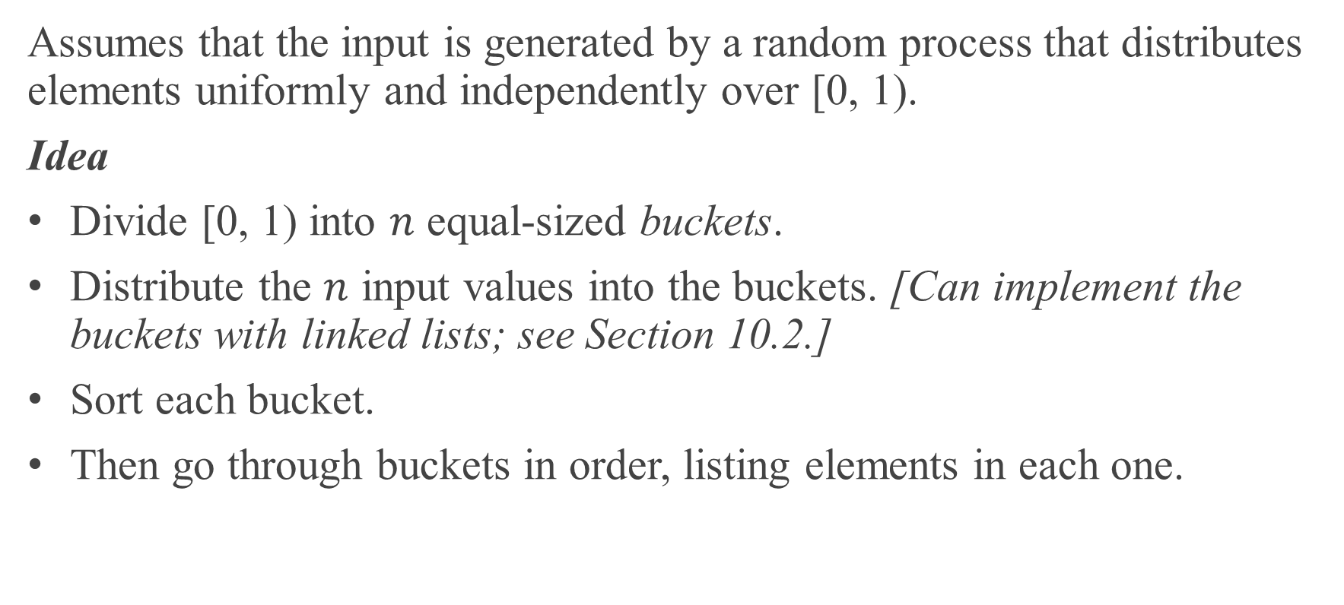
BUCKET SORT
Assumes that the input is generated by a random process that distributes elements uniformly and independently over [0, 1).
Idea
Divide [0, 1) into $n$ equal-sized buckets.
Distribute the $n$ input values into the buckets. [Can implement the buckets with linked lists; see Section 10.2.]
Sort each bucket.
Then go through buckets in order, listing elements in each one.

Slide 22
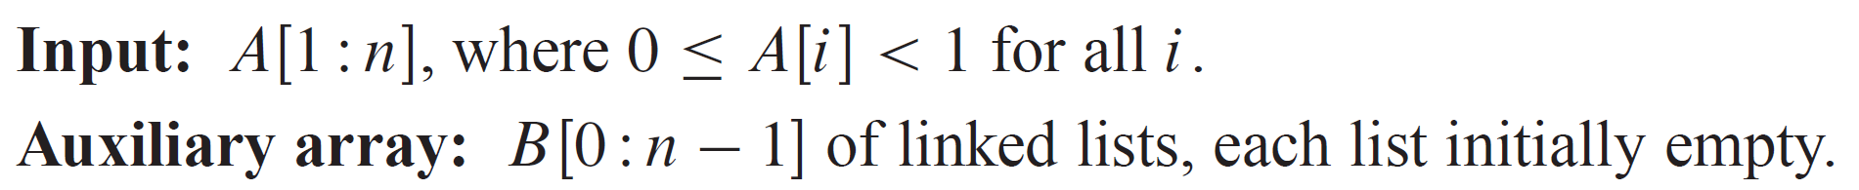
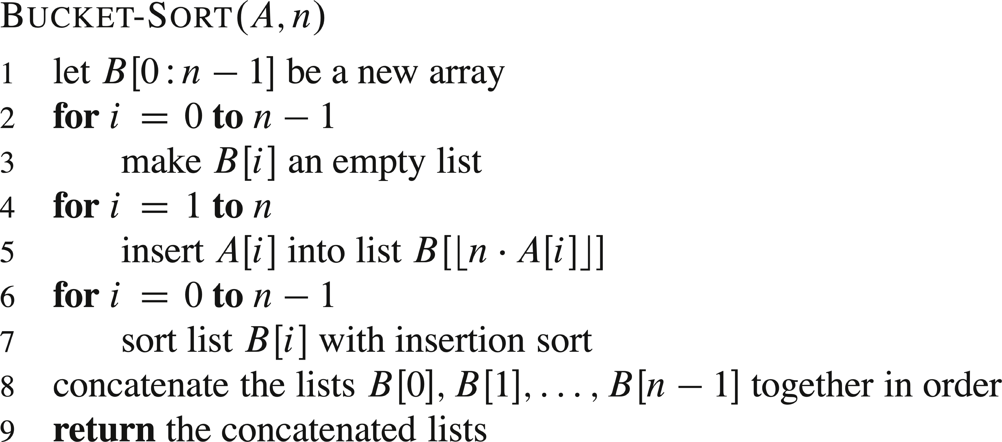
PSEUDOCODE

Slide 23
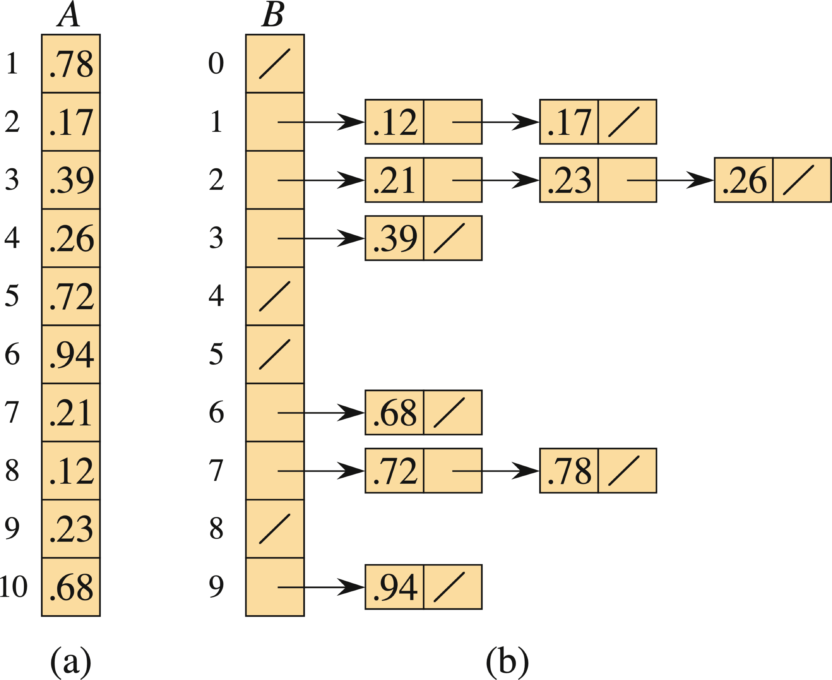
EXAMPLE
The buckets are shown after each has been sorted.

Slide 24
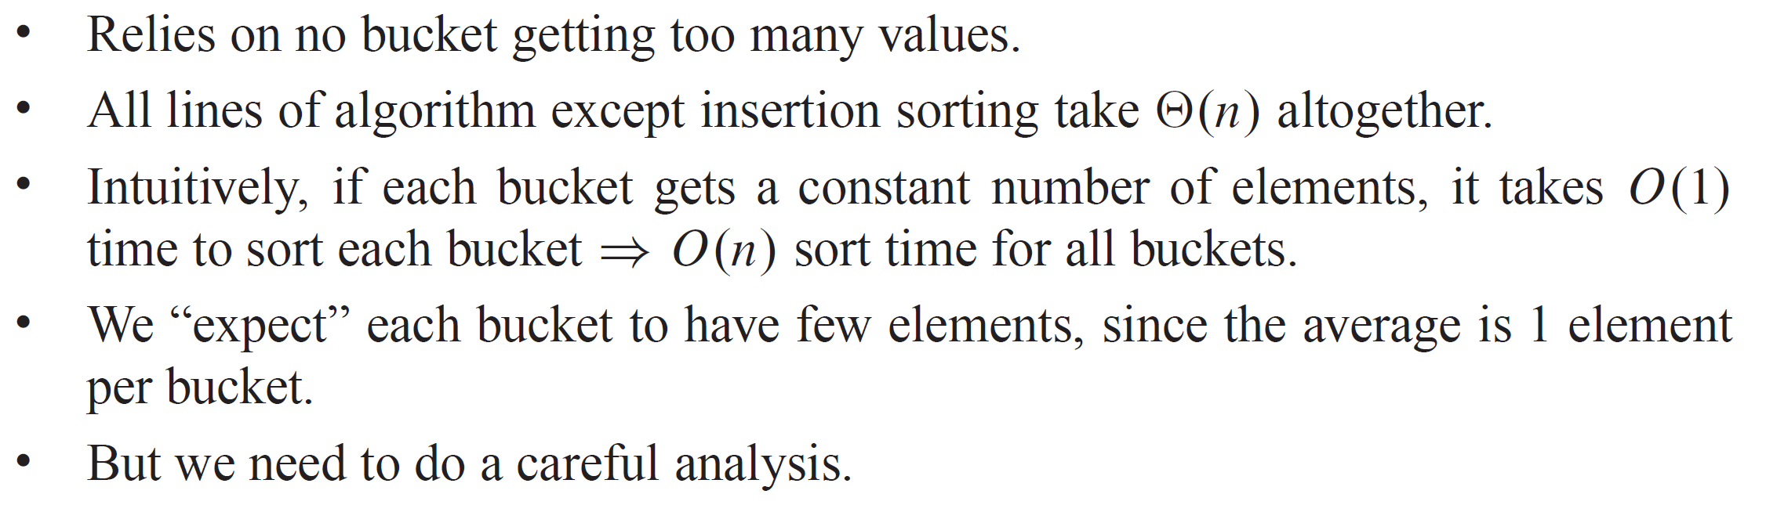
ANALYSIS

Slide 25
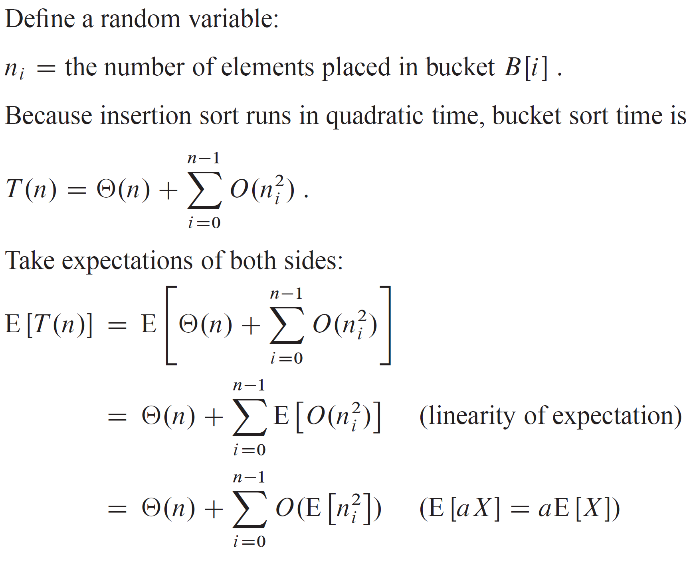
ANALYSIS (continued)

Slide 26
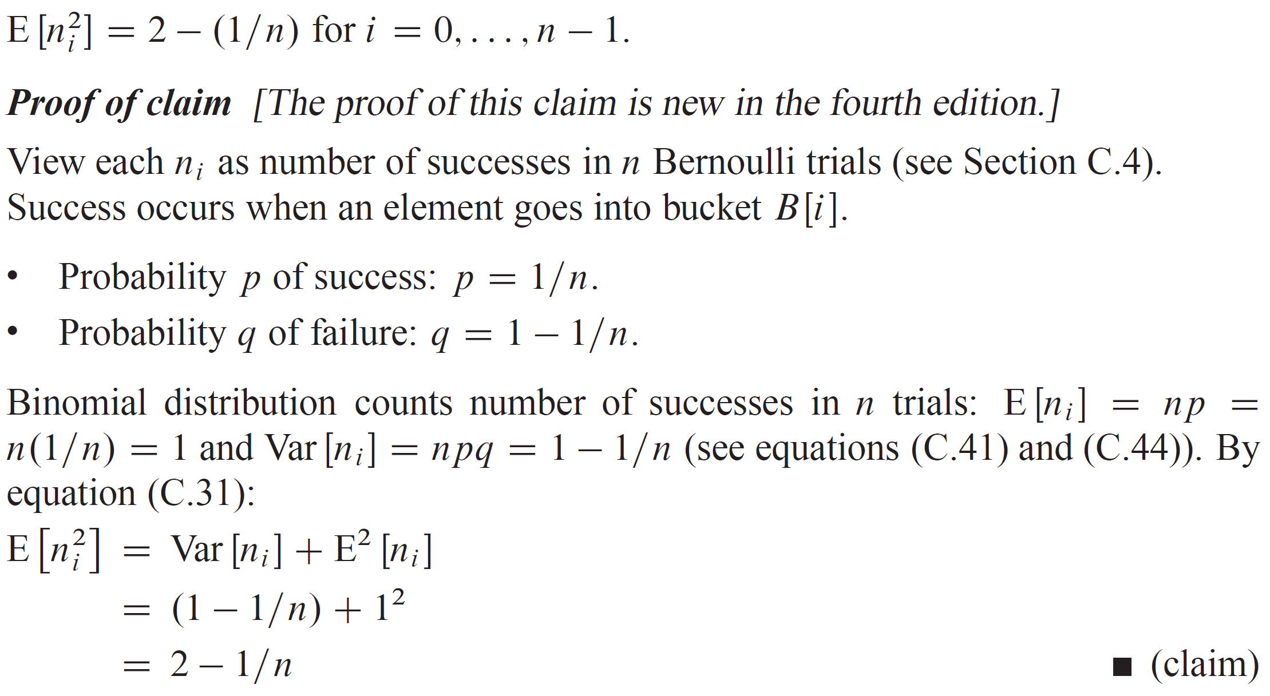
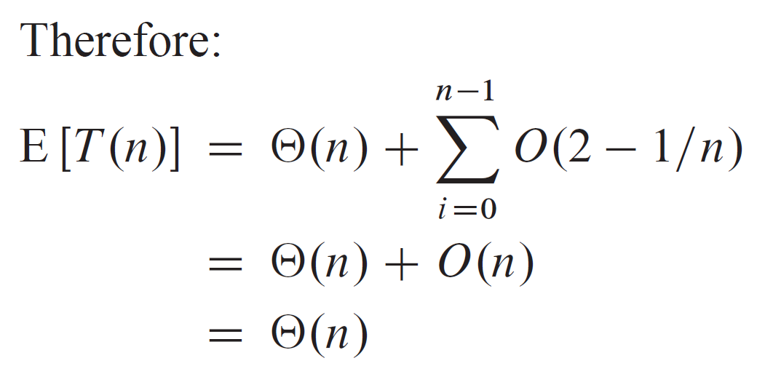
CLAIM

Slide 27
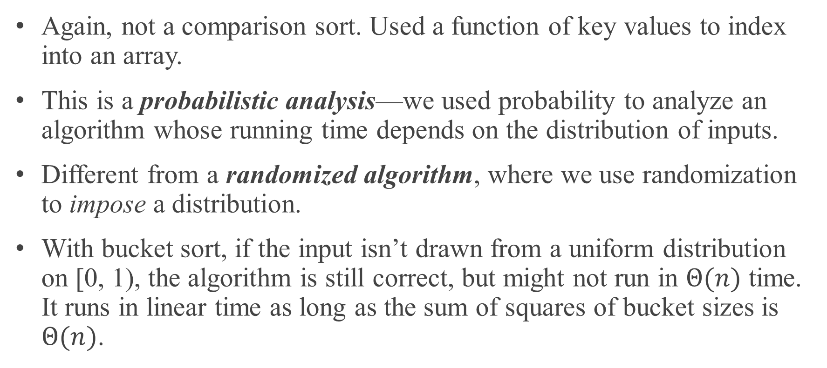
CLAIM (continued)
Again, not a comparison sort. Used a function of key values to index into an array.
This is a probabilistic analysis—we used probability to analyze an algorithm whose running time depends on the distribution of inputs.
Different from a randomized algorithm, where we use randomization to impose a distribution.
With bucket sort, if the input isn’t drawn from a uniform distribution on [0, 1), the algorithm is still correct, but might not run in $Θ(n)$ time. It runs in linear time as long as the sum of squares of bucket sizes is $Θ(n)$.

